Slide 1
Making the Single ICT Space a Reality

Slide 2
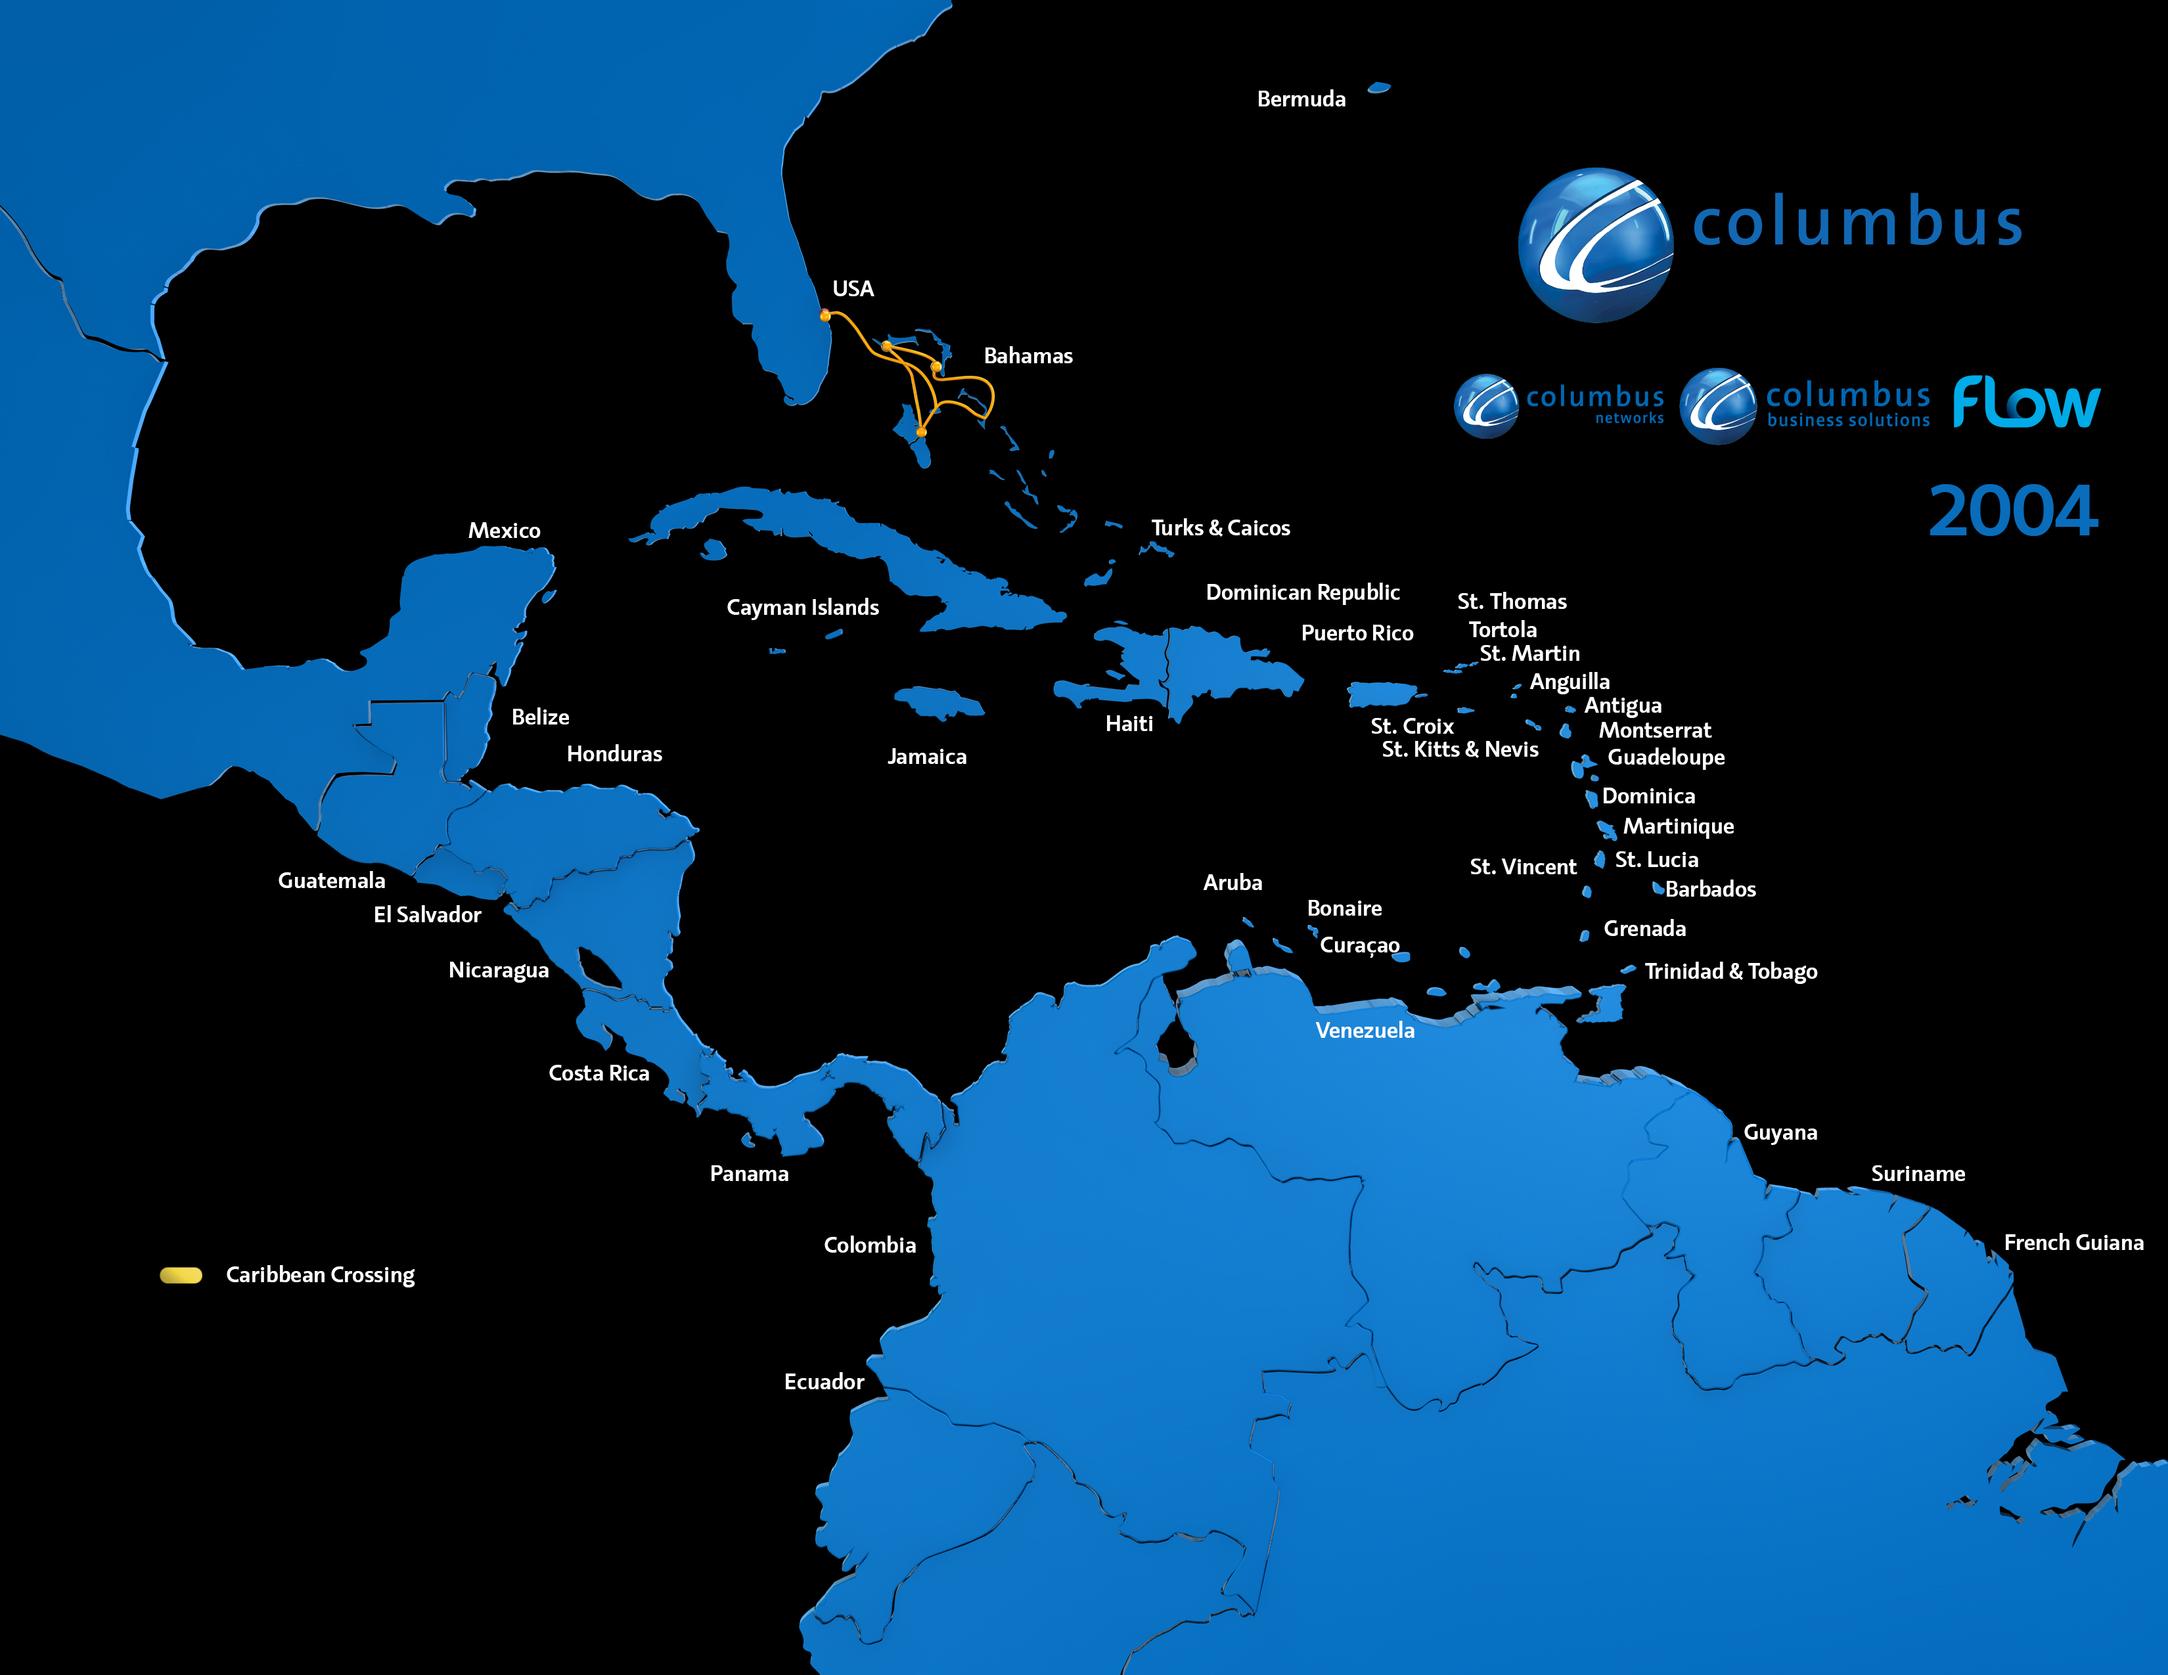

Slide 3
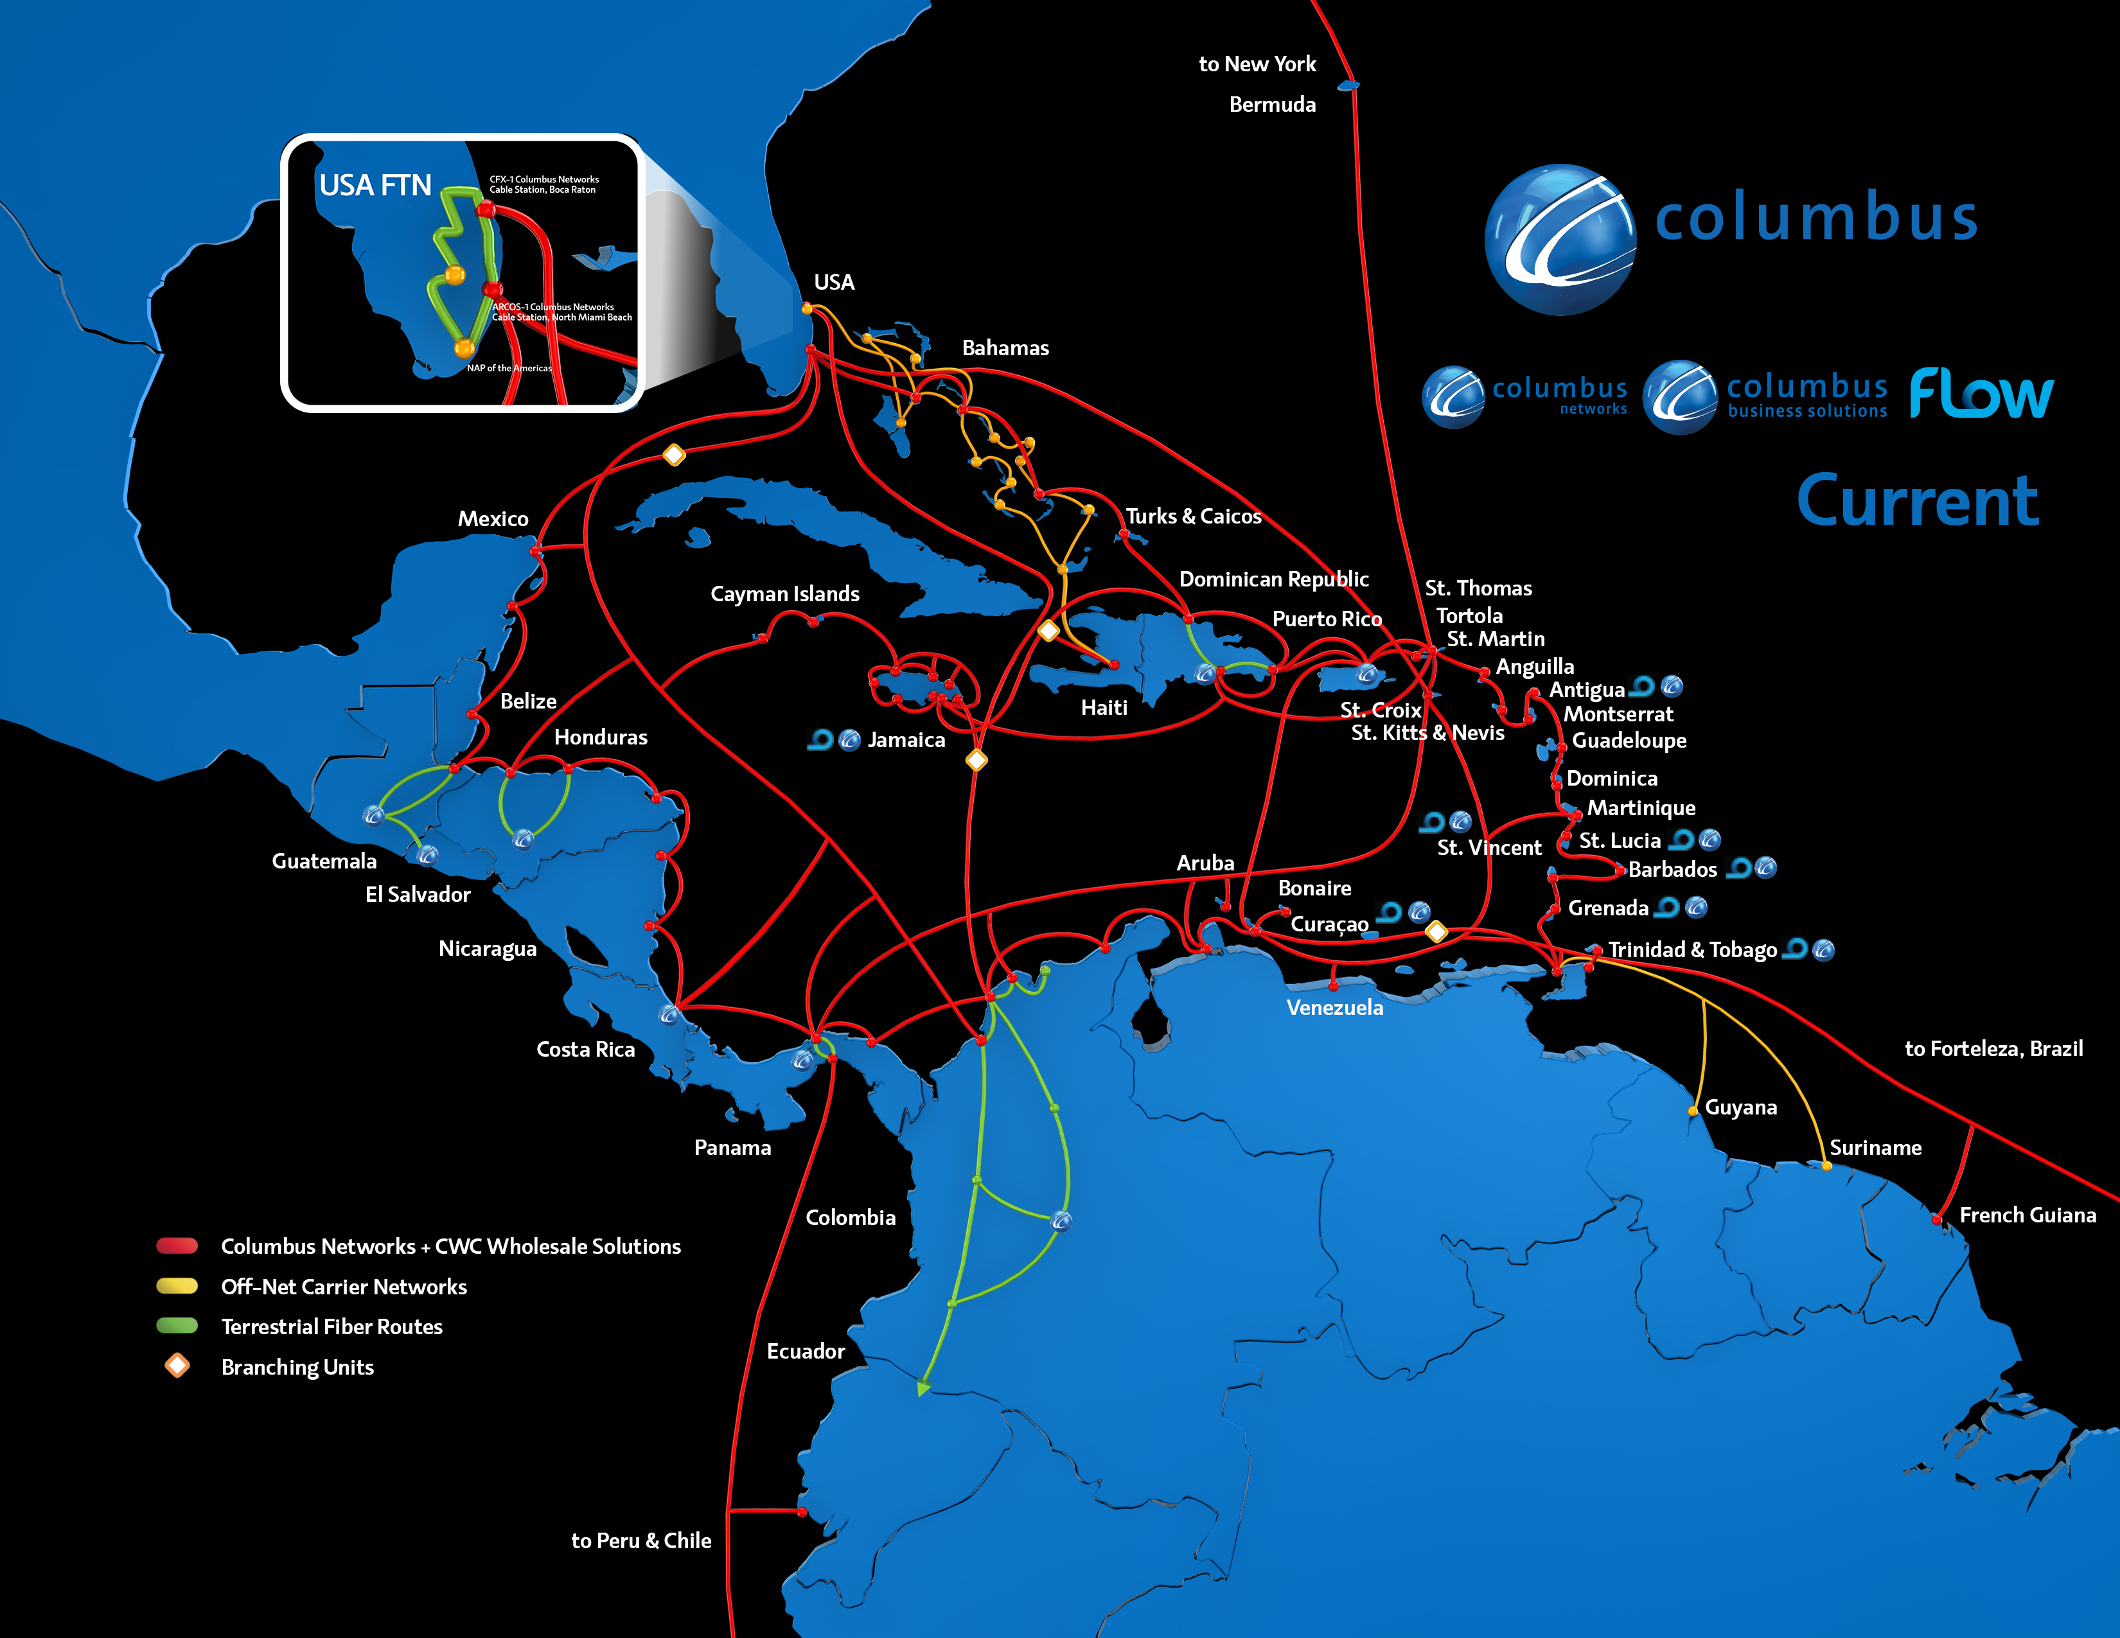
Network Evolution ‒ Current

Slide 4
There should be no boundaries
Partnership with Digicel to connect Haiti
…and with C&W to expand subsea capacity

Slide 5
Broadband Application

Slide 6
New Product and Service Development
Access to Basic Services
ICT in Education
ICT Patents
Knowledge-Intensive Jobs
Government Efficiency through ICT
New Development Models
E-Participation

Slide 7
Learn from our Lessons a.k.a Collaboration is Key

Slide 8
Content GENERATION
School Innovations
National / Regional Initiatives
Special Programmes
Content DISTRIBUTION
Online
Cable
Traditional
Technical CAPACITY
Broadband & Cloud Services
Production Facilities
Infrastructure

Slide 9
Year One: Results
First Indigenous Caribbean Digital Media Syllabus Created
Syllabus Creation from 2 years to 6 months
Reducing Costs and Creating Efficiencies
e-Marking – 9,000 scripts in 18 countries in 1 week
e-Registration
Data Storage for Results Archive
Web Hosting – for online community sharing portals

Slide 10
1
3
Education Technology
Digital Content Creation
Community Empowerment
Public Awareness
Tech Innovation
4
2
5

Slide 11
Results So Far
Mobile App Development Workshops
Started: 2007
Dominica, St Kitts and Nevis, Grenada, Antigua and Barbuda , Trinidad and Tobago, Belize,
Impact: 5,000 Children
Local Digital Content Creation
Started: 2013
Grenada, Antigua and Barbuda, Barbados, St Lucia
Impact: 1,000 Children

Slide 12
Single ICT Space
Form Will Follow Function

Slide 13
THANK YOU

Slide 14
Making the Single ICT Space a Reality

