Slide 1
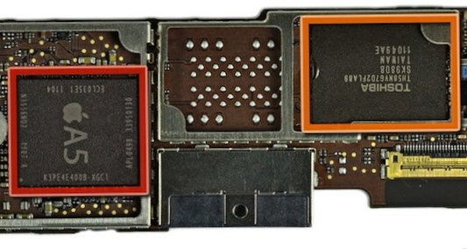
Which product do you prefer?
Integrated Video Solutions
How technology changes the way we experience television
©Anil Sadhoeram | MD Divitel Americas

Slide 2
With so much noise in our industry…

Slide 3
How
do
you
know
you are
heading
in the
right direction?

Slide 4
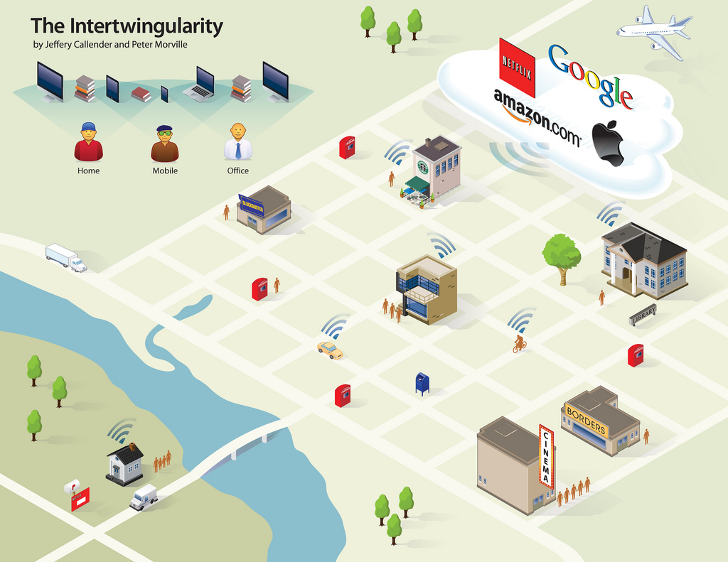
Technology makes crossmedia delivery possible, content anytime anywhere

Slide 5
Who are we?
Solutions provider & systems integrator
for professional video systems
Specialized in: Focus on: Offices in:
- System design - Cable Operators - The Netherlands
- Engineering - DSL Operators - Germany
- Integration - Telco Operators - Portugal (Software)
- Operational control - FTTH Operators - Curacao
- Turn key projects - Broadcasters
- 24/7 support

Slide 6
It’s not just about Technology,
we also work together with our clients
on the
Business case!

Slide 7
Bigger Picture: Services that can be deployed
Linear TV (SD + HD)
Video on Demand
Network PVR
Catch up TV
Restart TV
Pause live TV
Widgets/Apps such as facebook, twitter and youtube
Multiscreen Video (tablets and smartphones)

Slide 8
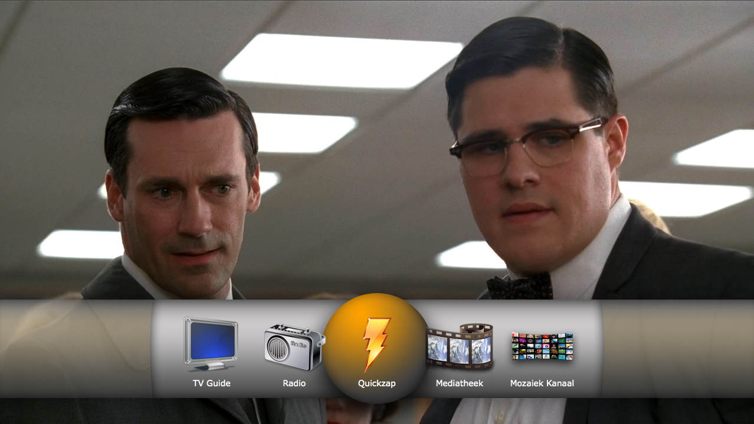
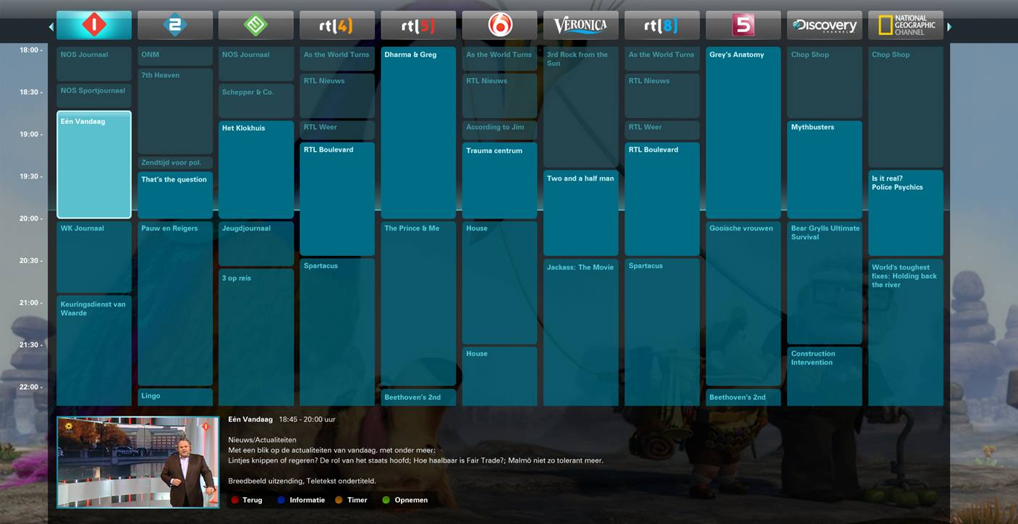
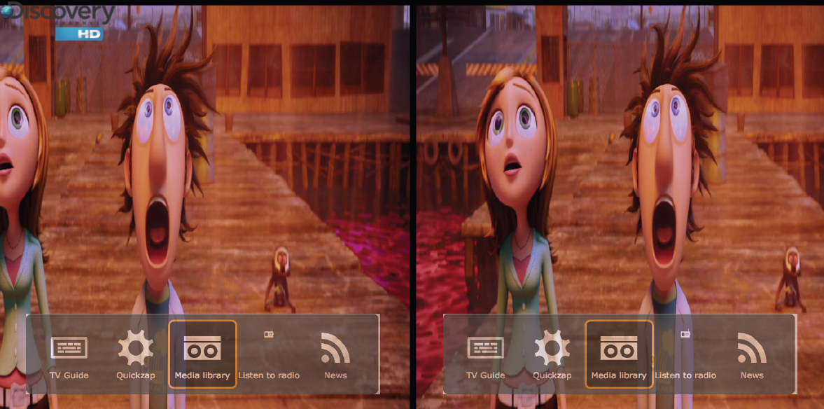
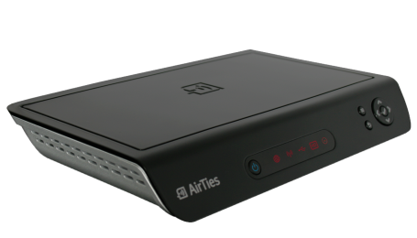
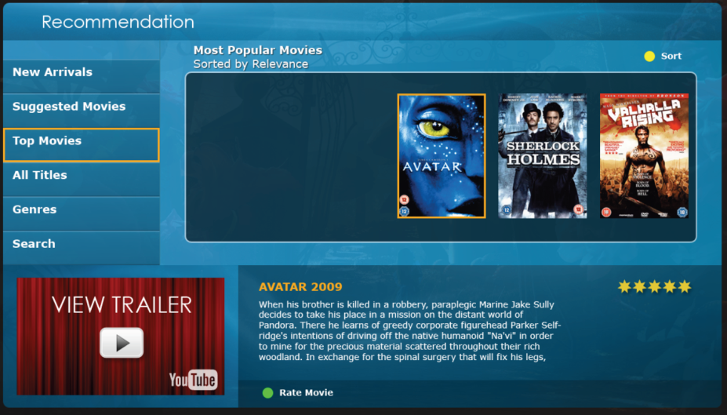
Embracing Innovations
Social TV
3D User Interface
HD user interface
VOD + Recommendation
Cloud TV
Widgets
& Apps
Promotions

Slide 9
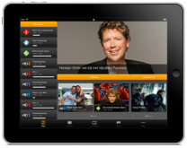
Smart Remote |Companion Device
3 Screens Video

Slide 10
High Tech + High Touch

Slide 11
Value Proposition
Independent Solution Provider with highly skilled and seasoned professionals
Trusted Technology Partner
Our roots are in technology, our route is the business case
We are a leading & knowledgeable company in our business
We benchmark all relevant leading and upcoming suppliers and work with best of breeds to build solutions

Slide 12
Some References
UTS: MMDS platform
Ziggo: IPTV/ iPad TV
KPN/Reggefiber: IPTV
ZDF: Compression platform
Hybrid IPTV: Cogas, KabelNoord
CAIW: IPTV

Slide 13
Technology changes
the way we watch television
So how can we help to keep competition at bay?

Slide 14
From analogue to digital

Slide 15
Building Blocks

Slide 16
Scrambling
Scrambling for:
Linear broadcast
iOS(iPad/iPhone/iPod touch) & Android
Video on Demand/nPVR

Slide 17
Transcoding & Packaging
Converts live(HD) content into mobile formats
iOS(iPad,iPhone,iPod Touch) & Android (smart phones & tablets)
Modular expansion of headend

Slide 18
Transcoding & Packaging Workflow

Slide 19
Video Delivery Network
Video delivery network for:
Video on Demand
LiveTV to VoD
Mobile clients
nPVR

Slide 20
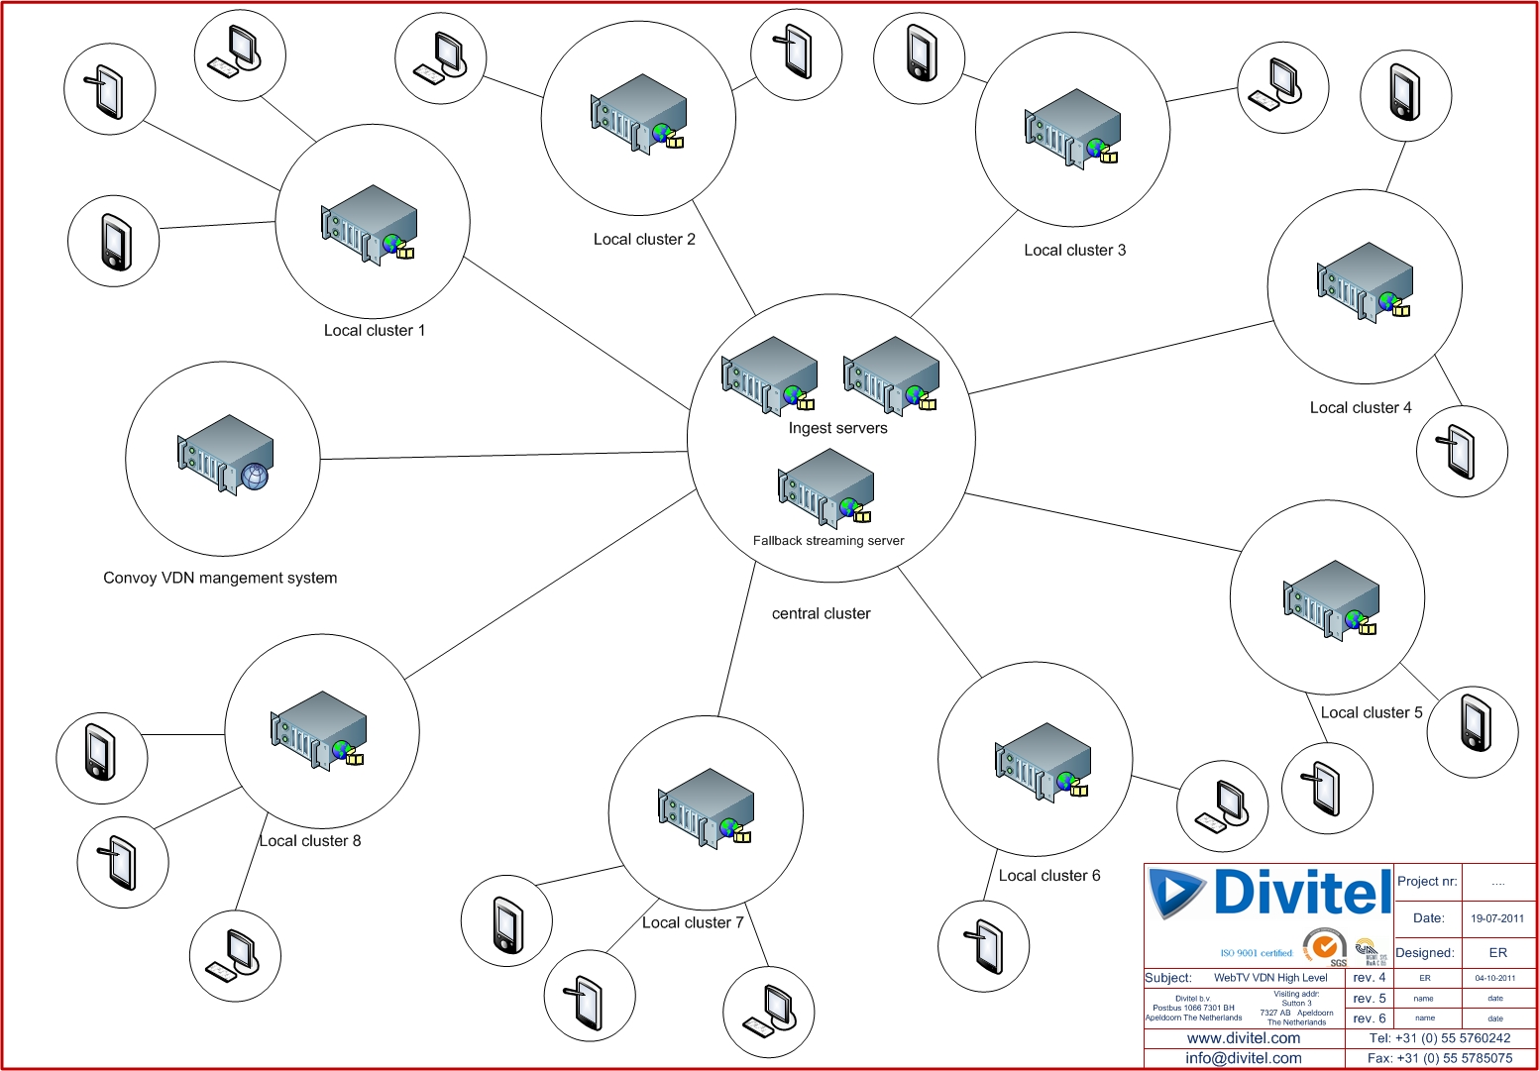
Video Delivery Network

Slide 21
Middleware

Slide 22
Questions…

Slide 23
M +5999 518 96 75 E anil.sadhoeram@divitel.com www.divitel.com
For more info please contact:

Slide 24
Appendix

Slide 25
Key IPTV application / services
VOD
(n)PVR
LiveTV to VoD (CatchupTV)
Restart TV
Pause live TV
Widgets

Slide 26
How to increase and create new revenues with Solution ?

Slide 27
VOD Shop
SD + HD

Slide 28
Navigate to VOD shop

Slide 29
VOD Shop Catalog (example)

Slide 30
Movie Info in the VOD Shop

Slide 31
VOD Rental is pincode protected

Slide 32
Recommendation Engine

Slide 33
Marking of EPG for Recording

Slide 34
Upsell of nPVR

